Slide 1
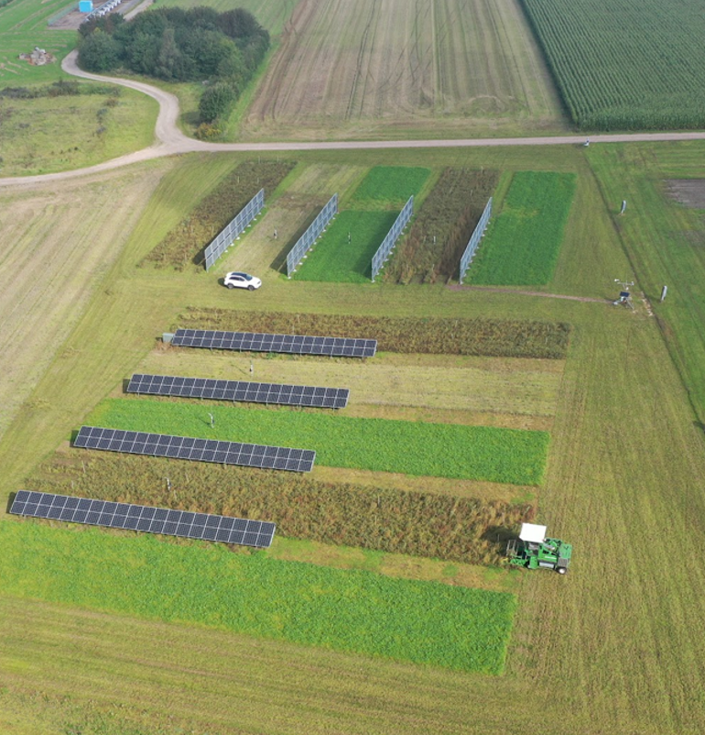
Master’s Thesis Defence
Modelling and Performance Investigation of a Bifacial Agrivoltaic Installation in Foulum

Slide 2
Agenda
1
4
How do vertical east-west and south-oriented PV modules perform in an agrivoltaic installation?
Introduction
Bifacial configurations
Methodology of the project
The PV systems
Overview of system
Sensors
Data for comparison
Data outages
Limits for inclusion
The Performance model
Transposition modelling
Module modelling
Inverter modelling
Results
Plane Of Array Irradiance
AC Power
System efficiencies
Conclusion
?
How does the modelling of the performance compare with experimental measurements?
2
5
?
What are the most relevant parameters to be measured and the best modelling approaches to improve the fitting?
3
6
?

Slide 3
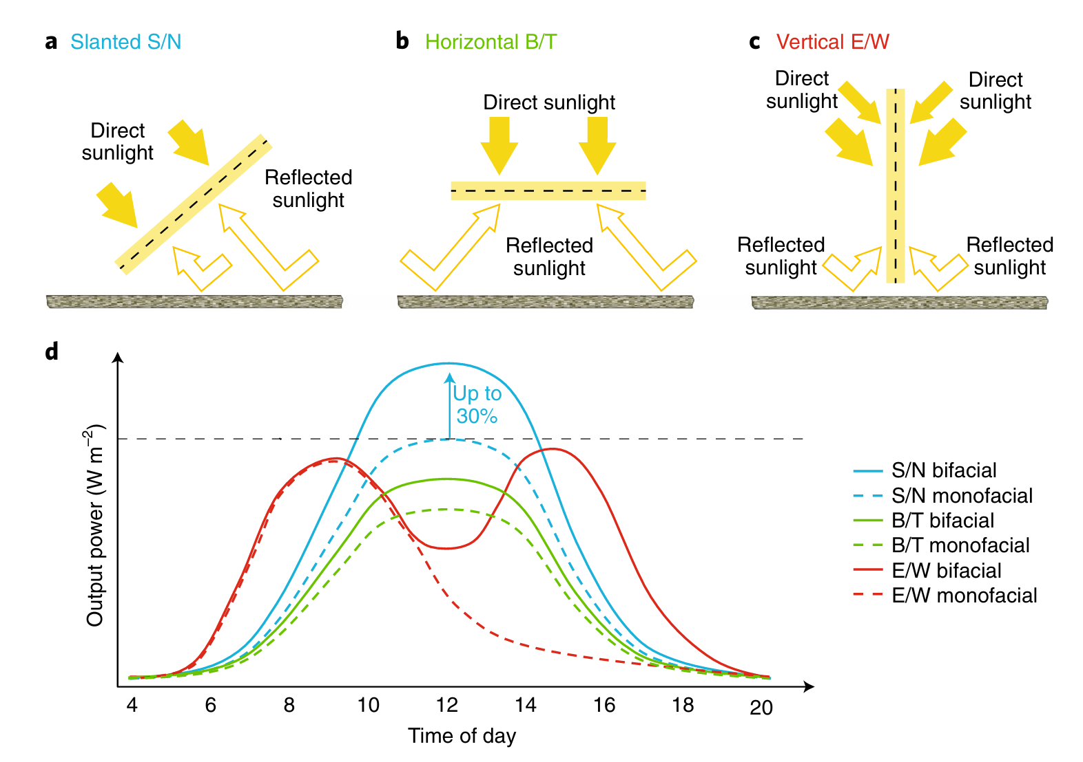
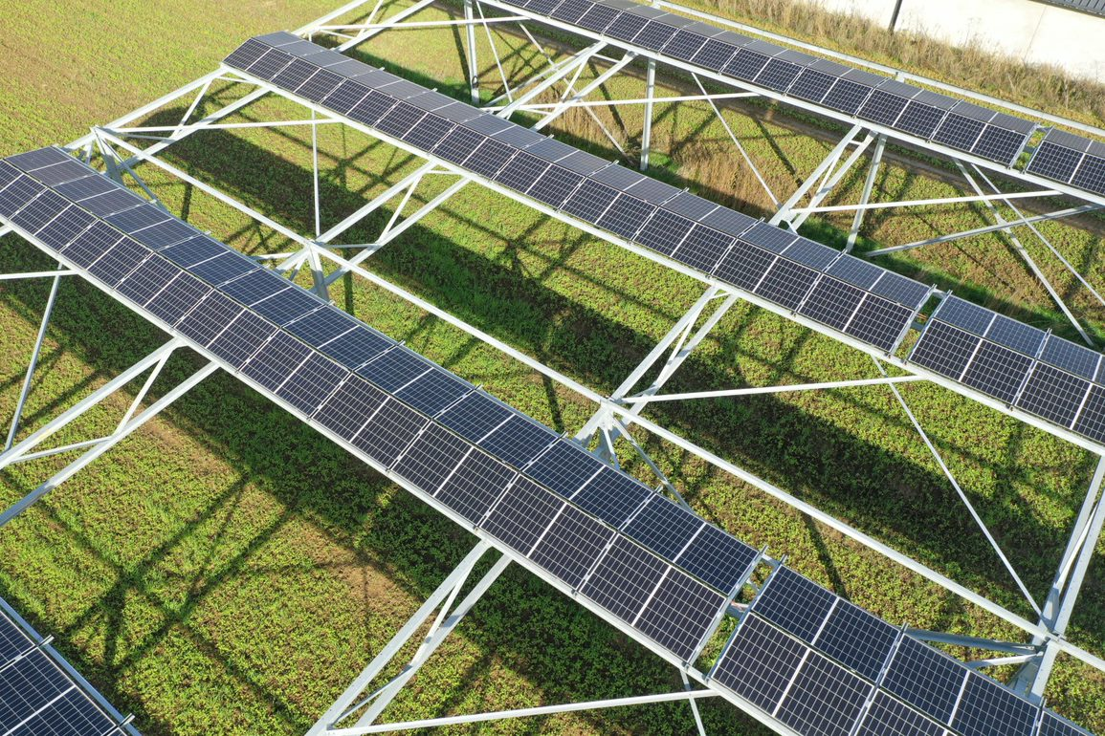
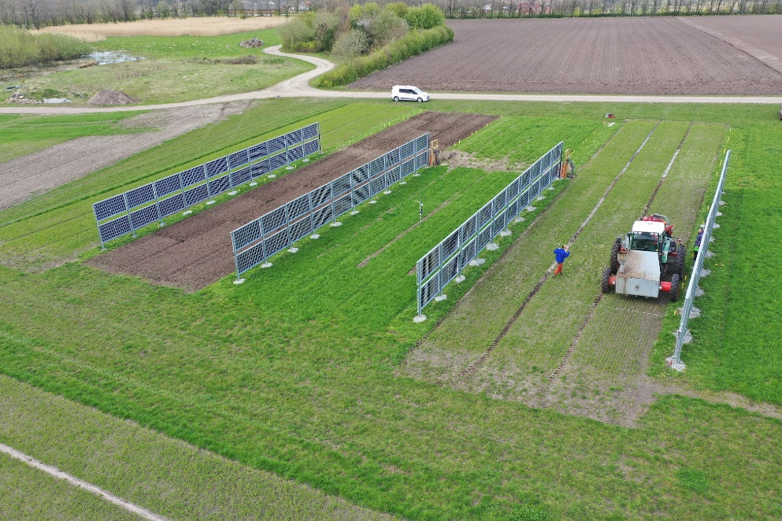
Introduction – Bifacial configurations
Silicon PV market is dominated by bifacial cell technology
Different generation profile -> potentially reducing balancing needs
Dual land use -> food and electricity production
Agrivoltaic installations can be used as windbreaks -> potentially increasing the yield
Source:Radovan Kopecek and Joris Libal. “Towards large-scale deployment of bifacial photovoltaics”. In: Nature Energy 3.6 (June 2018), pp. 443–446. issn: 2058-7546. doi: 10.1038/s41560- 018-0178-0. url: https://doi.org/10.1038/s41560-018-0178-0.

Slide 4
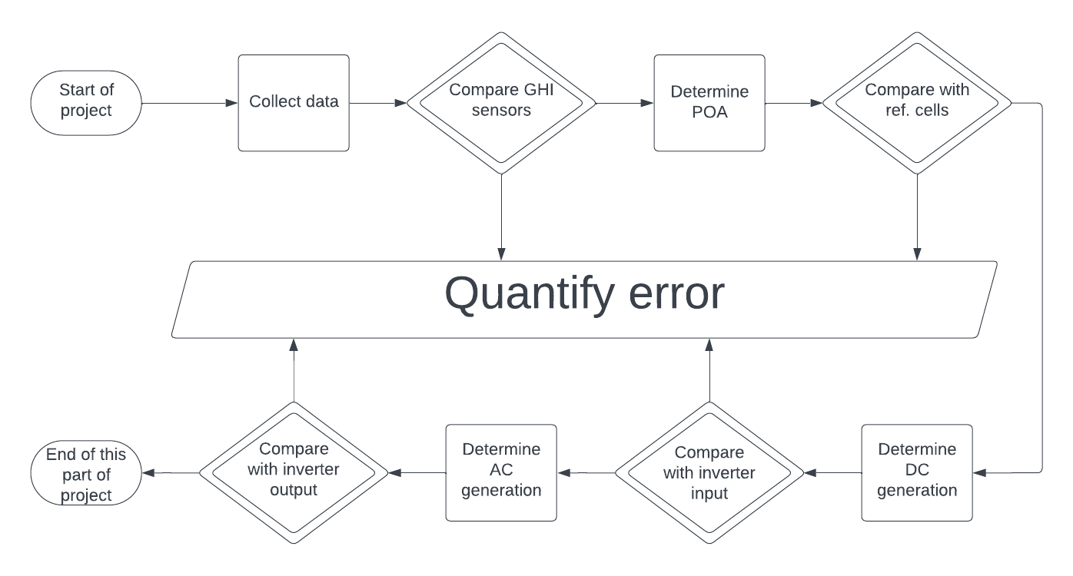
Methodology overview

Slide 5
The pv installation

Slide 6
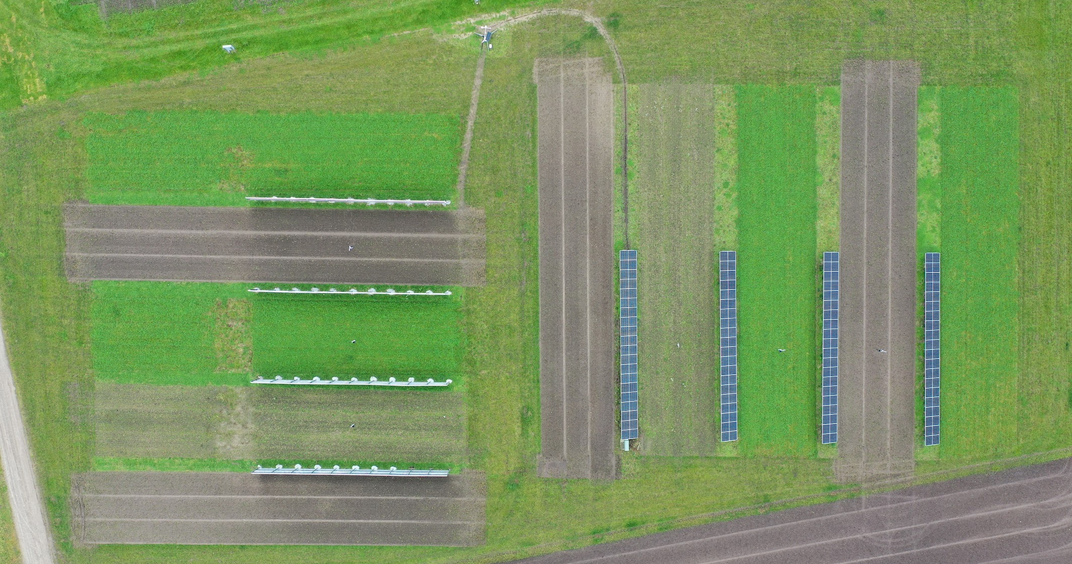

E
Weather station
N
S
W
REF. Cell
2*REF. Cell
REF. Cell

Slide 7
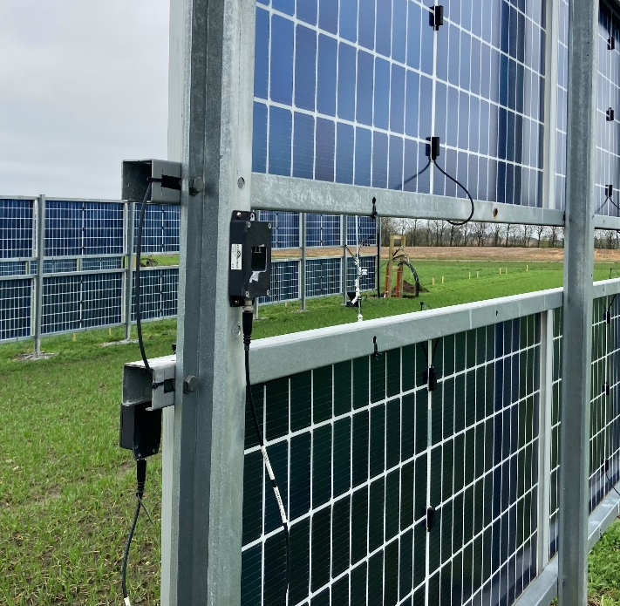
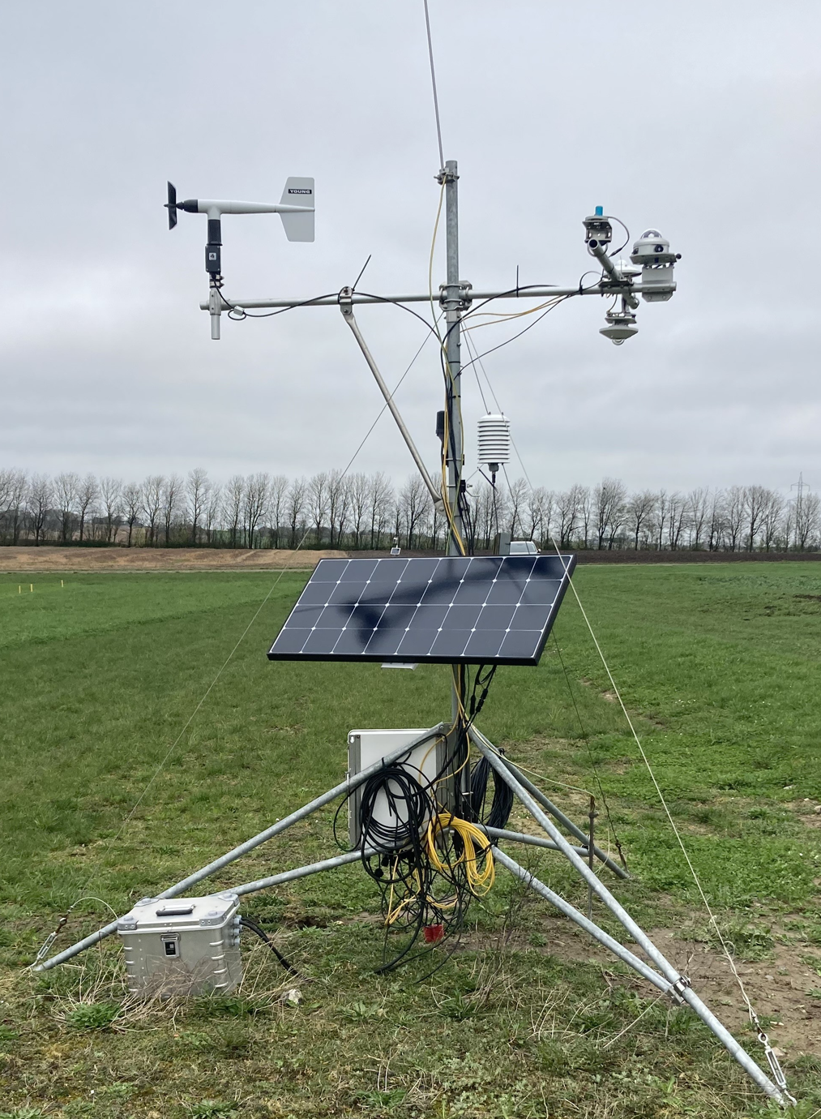
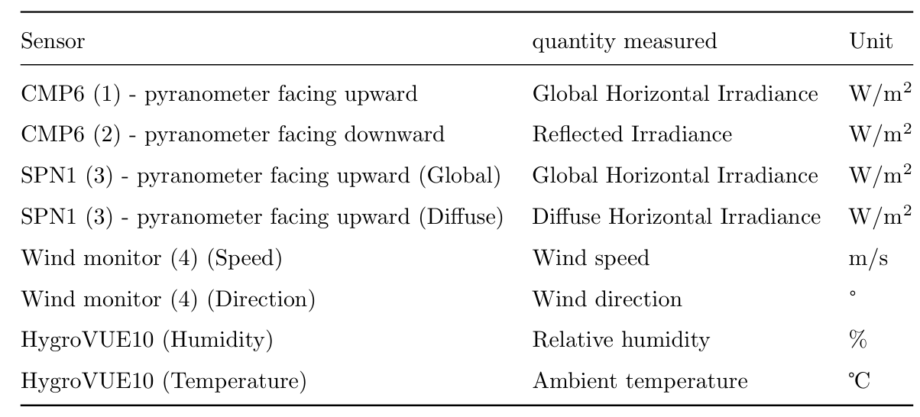
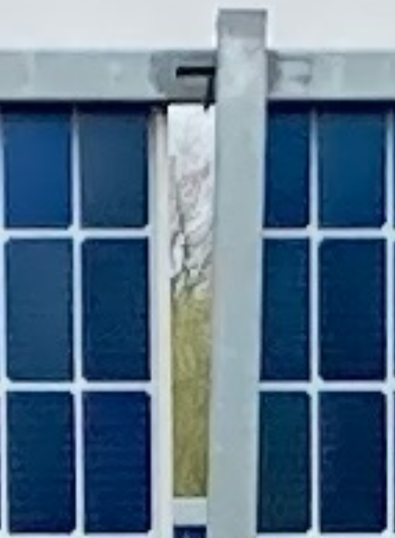
On-site measurements
Provides the input for the Performance Model and comparisons
Reference cells are not affected by shadows from the structure
5-minute resolution

Slide 8
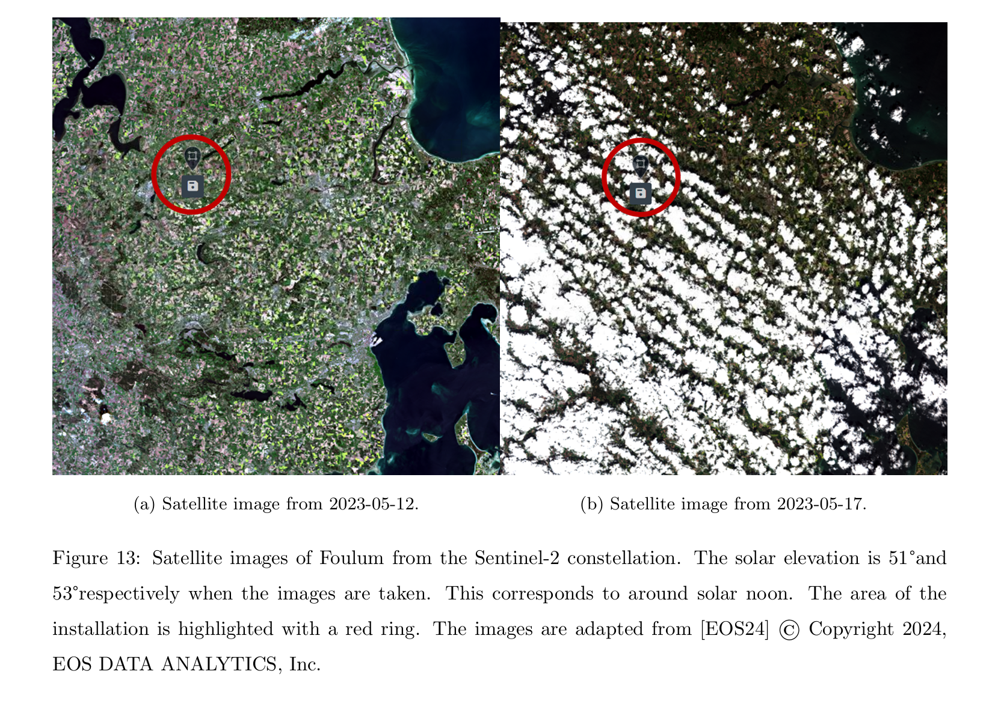
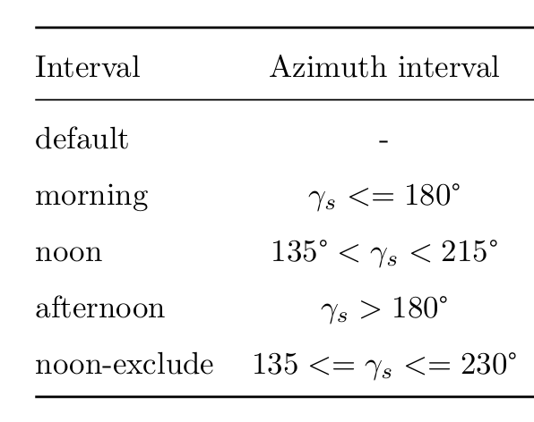
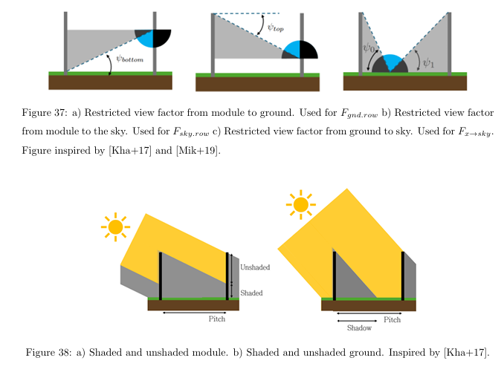
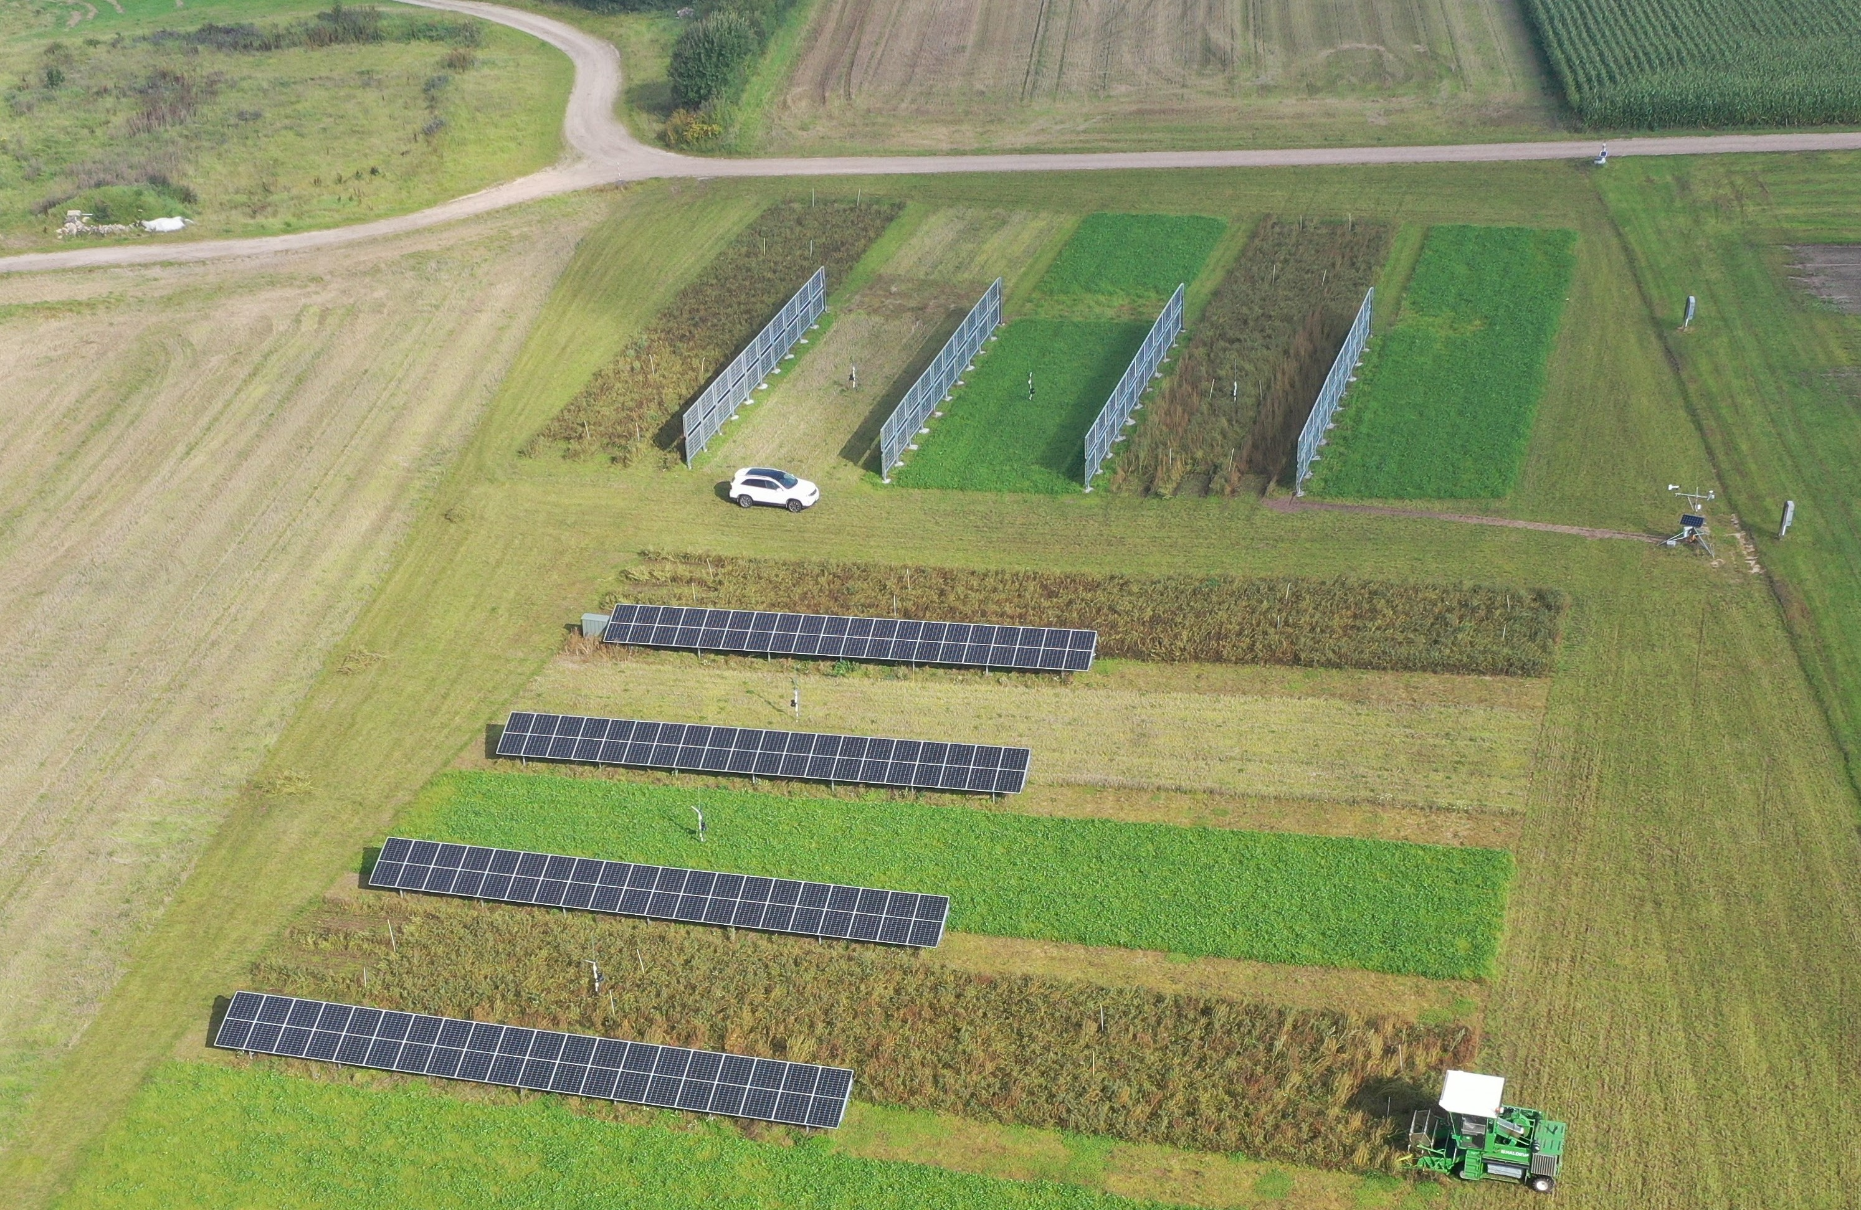
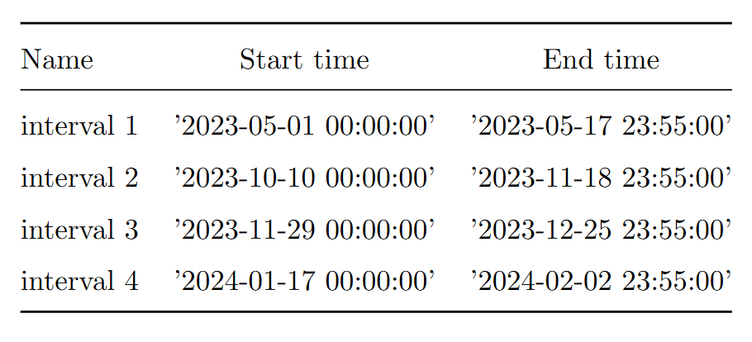
Data for comparison
Clear sky and cloudy conditions
Data outages
Both long intervals and individual days
One long interval from four short – 101 days
Comparison limits

Slide 9
The Performance Model
From astronomy to energy

Slide 10
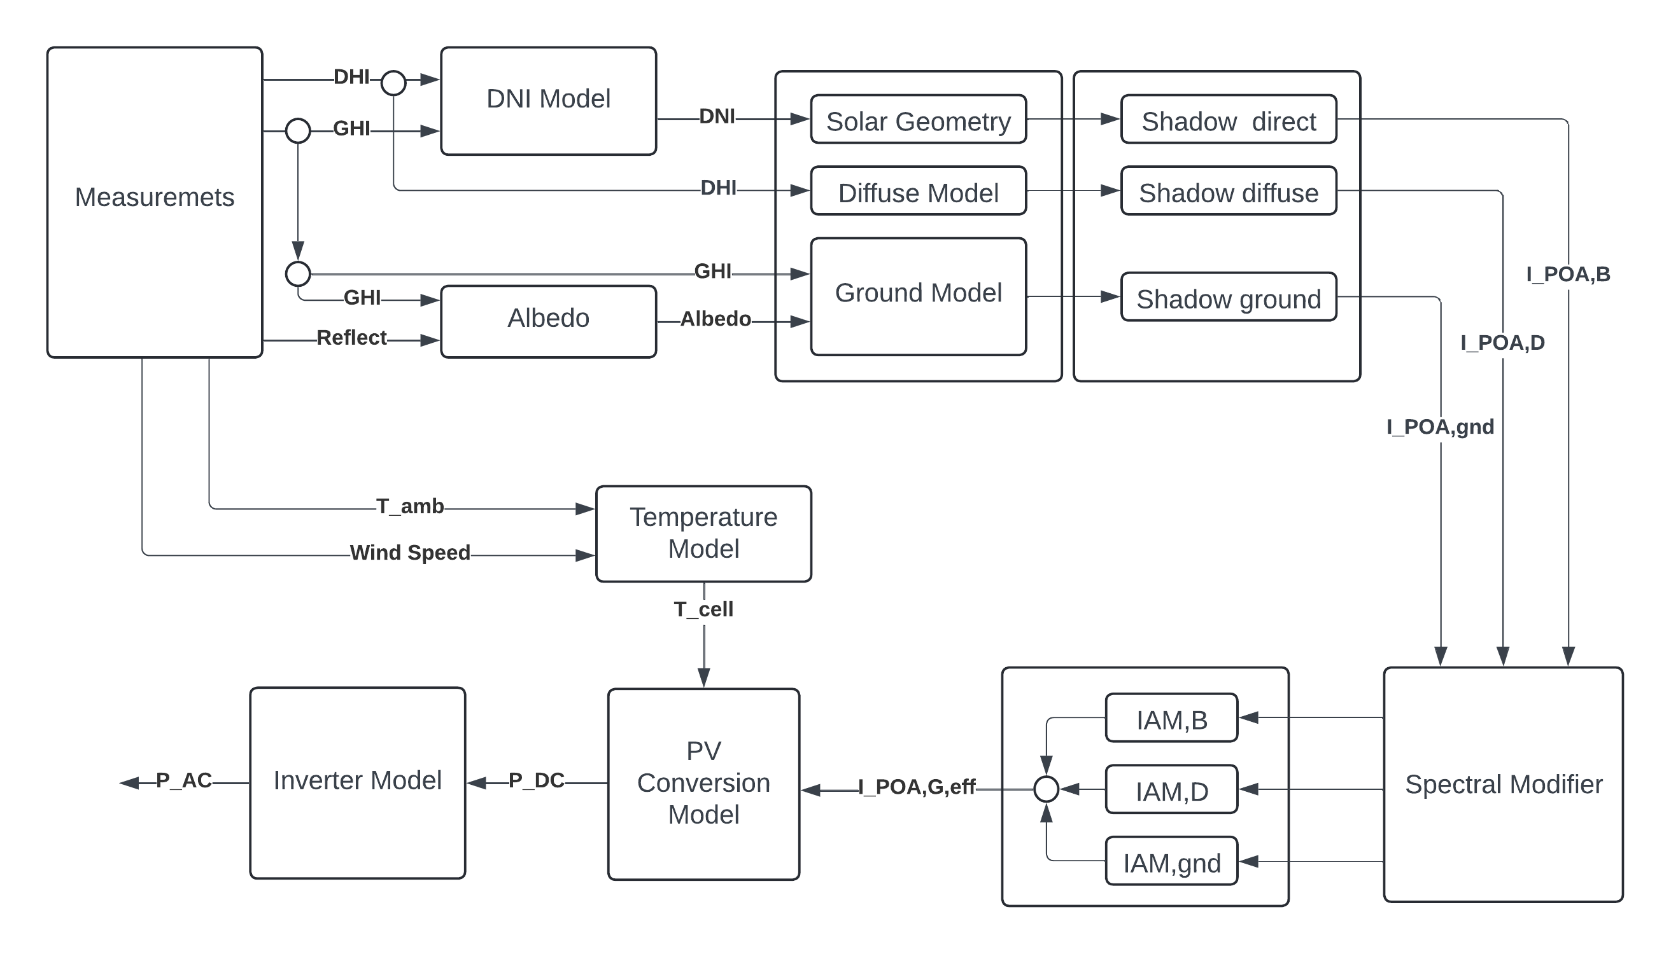
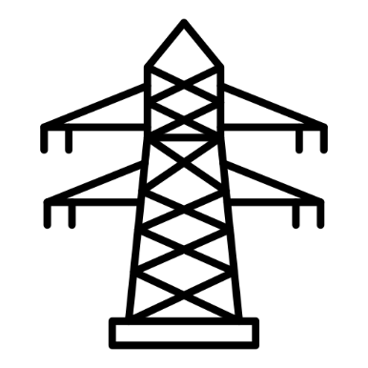


The model chain
Inputs to model
Transposition - Simple
Shadow model
Transposition Model
Module Model

Slide 11
The model chain
Inputs to model
Transposition - Simple
Shadow model
Transposition Model
Module Model

Slide 12
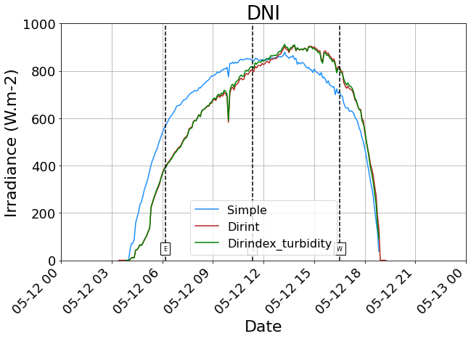
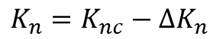
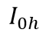
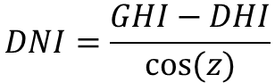
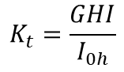
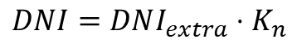
Dni model
Empirical models has skewness
Simple geometry more symmetric
Empirical models using only GHI
$$DNI=DNI_{extra}⋅K_{n}$$
$$K_{n}=K_{nc}−ΔK_{n}$$
Solar radiation beam transmittance based on clear-sky model clearness index
Geometry model using GHI and DHI
$$K_{t}=\frac{GHI}{I_{0h}}$$
$$DNI=\frac{GHI−DHI}{cos⁡(z)}$$
$$I_{0h}$$
Horizontal extraterrestrial irradiance

Slide 13
Dni model
Empirical models has skewness
Simple geometry more symmetric
Empirical models using only GHI
$$DNI=DNI_{extra}⋅K_{n}$$
$$K_{n}=K_{nc}−ΔK_{n}$$
Solar radiation beam transmittance based on clear-sky model clearness index
Geometry model using GHI and DHI
$$K_{t}=\frac{GHI}{I_{0h}}$$
$$DNI=\frac{GHI−DHI}{cos⁡(z)}$$
$$I_{0h}$$
Horizontal extraterrestrial irradiance

Slide 14
The model chain
Inputs to model
Transposition - Simple
Shadow model
Transposition Model
Module Model

Slide 15
The model chain
Inputs to model
Transposition - Simple
Shadow model
Transposition Model
Module Model

Slide 16
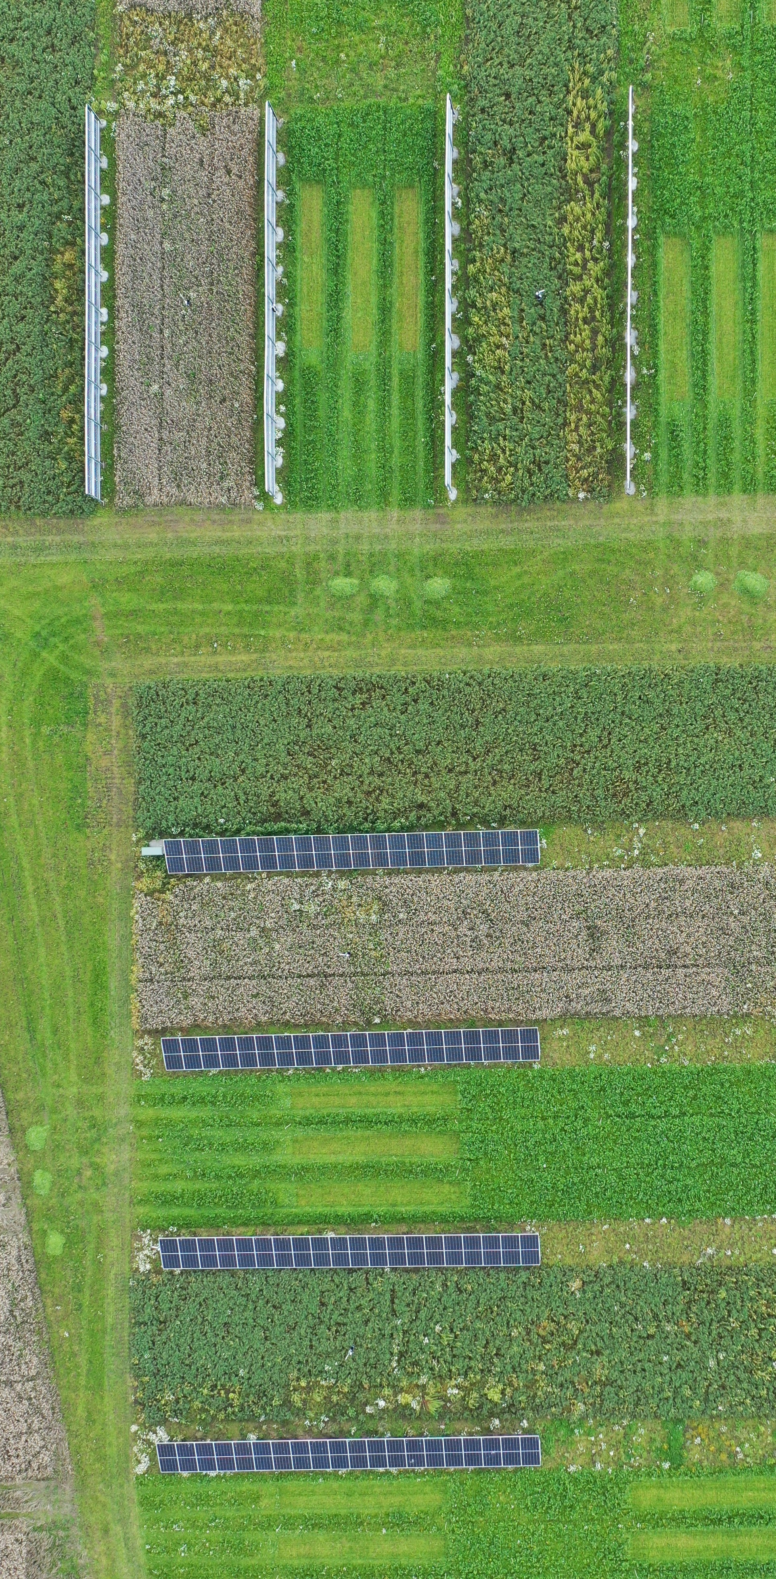
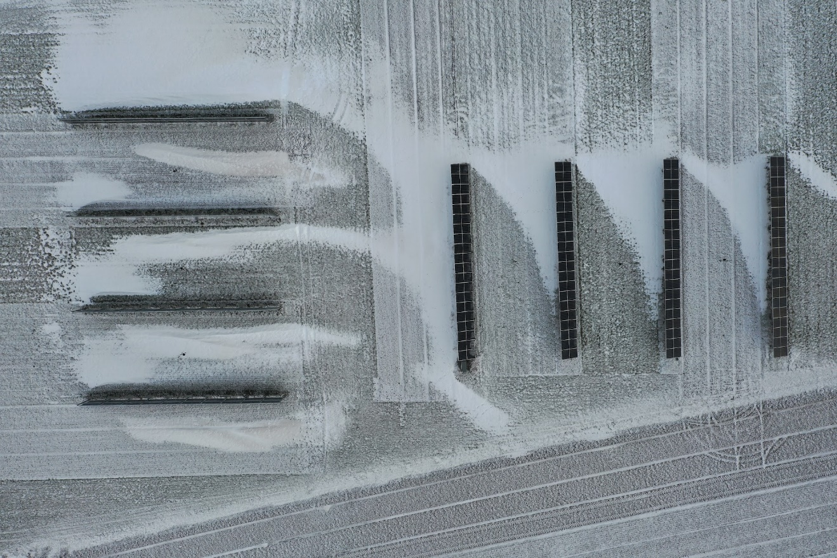
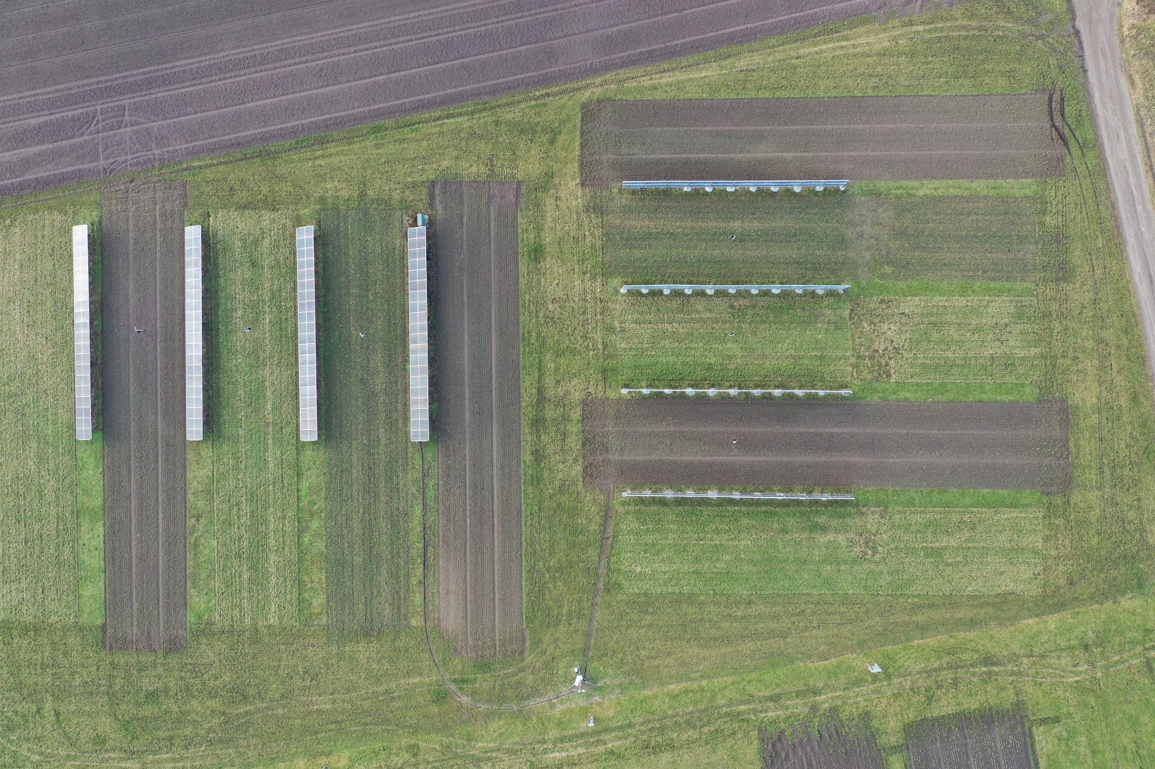
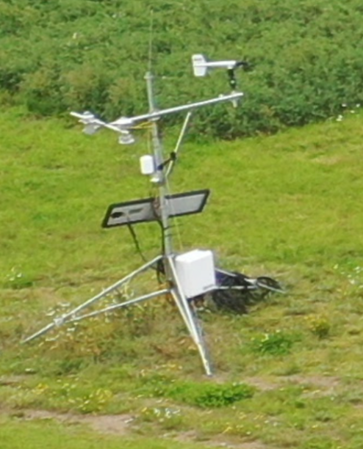
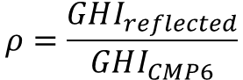
Albedo
2023-08-14
2024-01-16
2024-01-25
$$ρ=\frac{GHI_{reflected}}{GHI_{CMP6}}$$
2023-08-10

Slide 17
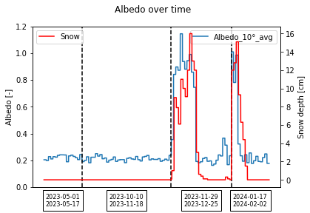
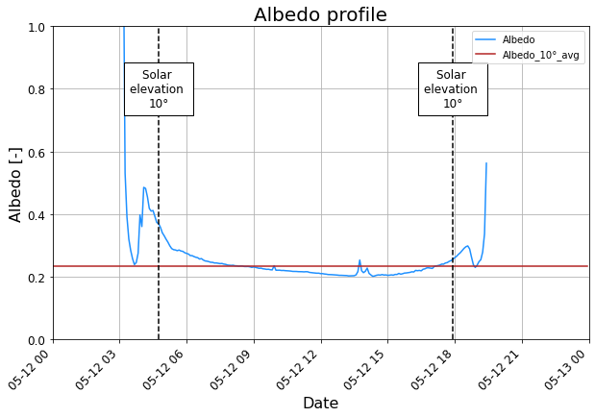
albedo
Average of midday
No seasonal variation
Snow increases the albedo

Slide 18
The model chain
Inputs to model
Transposition - Simple
Shadow model
Transposition Model
Module Model

Slide 19
The model chain
Inputs to model
Transposition - Simple
Shadow model
Transposition Model
Module Model

Slide 20
The model chain
Inputs to model
Transposition - Simple
Shadow model
Transposition Model
Module Model

Slide 21
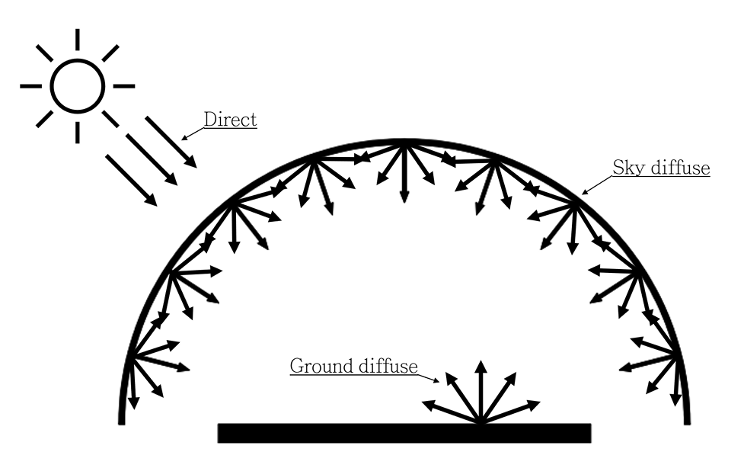
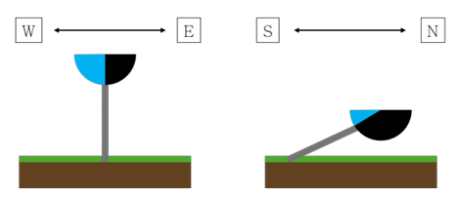
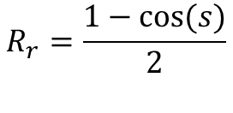
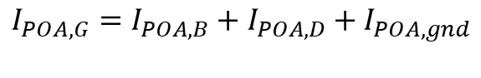
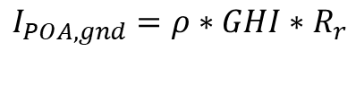
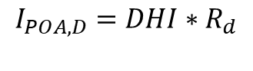
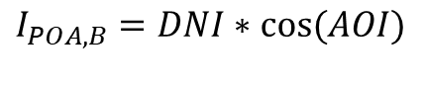
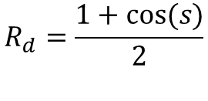
Transposition - One row approach
Three main components
$$I_{POA,G}=I_{POA,B}+I_{POA,D}+I_{POA,gnd}$$
Direct – solar geometry
$$I_{POA,B}=DNI∗cos⁡(AOI)$$
Sky diffuse – sky model
$$I_{POA,D}=DHI∗R_{d}$$
Ground diffuse – isotropic
$$I_{POA,gnd}=ρ∗GHI∗R_{r}$$
Transposition factors - isotropic
$$R_{r}=\frac{1−cos⁡(s)}{2}$$
$$R_{d}=\frac{1+cos⁡(s)}{2}$$

Slide 22
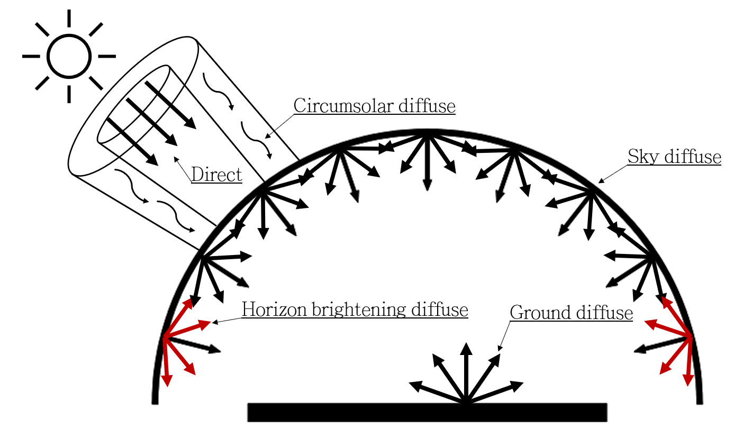
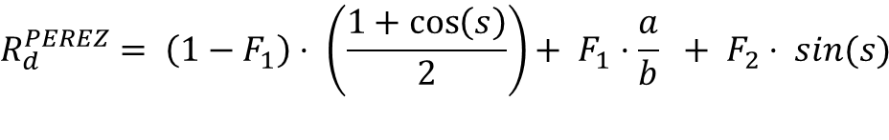
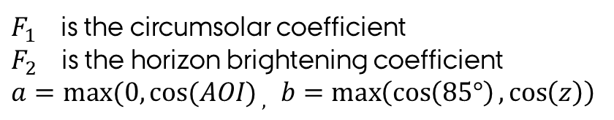
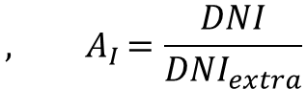
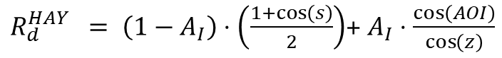
One row approach – sky models
HayDavies: Introduces diffuse circumsolar irradiance
$R_{d}^{HAY} = \left(1−A_{I}\right)⋅\left(\frac{1+\cos\left(s\right)}{2}\right)$+ $A_{I}⋅\frac{\cos\left(AOI\right)}{\cos\left(z\right)}$
$${, A}_{I}=\frac{DNI}{DNI_{extra}}$$
isotropic
circumsolar
PEREZ: Introduces diffuse horizon brightening irradiance
$$R_{d}^{PEREZ}= \left(1−F_{1}\right)⋅ \left(\frac{1+\cos\left(s\right)}{2}\right)+ F_{1}⋅\frac{a}{b} + F_{2}⋅ sin(s)$$
isotropic
circumsolar
horizon
$F_{1 }$is the circumsolar coefficient
$F_{2 }$is the horizon brightening coefficient
${a=max⁡(0,cos⁡(AOI)}_{ , }b=\max\left(\cos\left(85°\right),\cos\left(z\right)\right)$

Slide 23
The model chain
Inputs to model
Transposition - Simple
Shadow model
Transposition Model
Module Model

Slide 24
The model chain
Inputs to model
Transposition - Simple
Shadow model
Transposition Model
Module Model

Slide 25
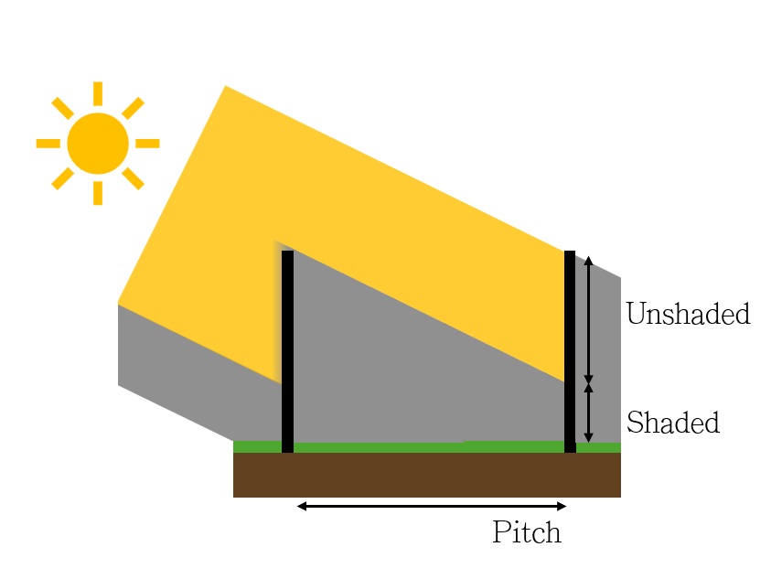
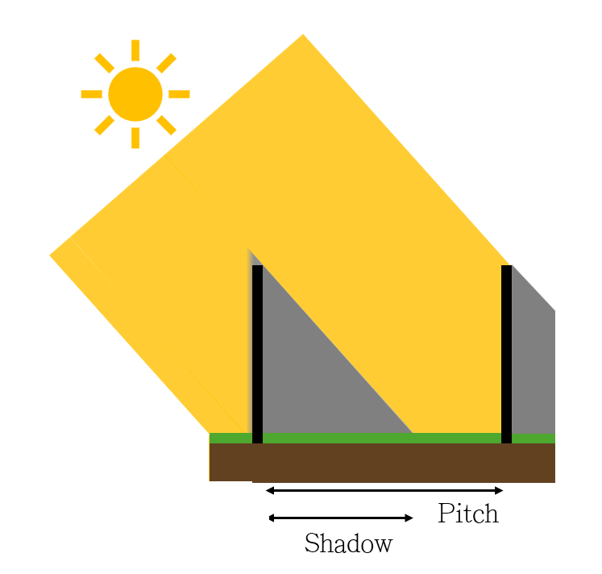
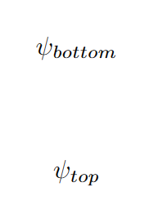
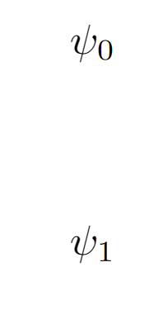
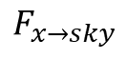
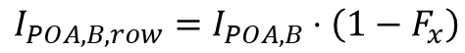
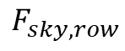



Transposition – shadows - infinite sheds
Infinitely many infinite rows – neglect edge effects
Only isotropic and haydavies sky model
Returns the average irradiance of the module
$$F_{x}$$
Adjustments to the one row approach
$$I_{POA,B,row}=I_{POA,B}⋅\left(1−F_{x}\right)$$
$$I_{POA,D,row,isotropic}=I_{POA,D,isotropic}⋅F_{sky,row}$$
$$I_{POA,gnd,row}=I_{POA,gnd}⋅F_{gnd,row}⋅\left(F_{sky.gnd}\left(1−df\right)+F_{x→sky}⋅df\right)$$
$$F_{gnd,row}$$
$$F_{sky,row}$$
$$F_{x→sky}$$
$$F_{sky.gnd}$$

Slide 26







Slide 27
The model chain
Inputs to model
Transposition - Simple
Shadow model
Transposition Model
Module Model

Slide 28
The model chain
Inputs to model
Transposition - Simple
Shadow model
Transposition Model
Module Model

Slide 29
The model chain
Inputs to model
Transposition - Simple
Shadow model
Transposition Model
Module Model

Slide 30







Spectral mismatch modifier
Accounts for absorption of solar radiation in the atmosphere
The coefficients depend on the cell technology
Effective plane of array irradiance
$$I_{POA,eff}=M⋅\left(IAM⋅I_{POA}\right)⋅SF$$
Sandia modifier
$$M_{SAPM}\left(AM_{a}\right)= a_{0} + a_{1}⋅ AM_{a} + a_{2}⋅ {\left(AM_{a}\right)}^{2}$$
$$+ a_{3}⋅ {\left(AM_{a}\right)}^{3} + a_{4}⋅ {\left(AM_{a}\right)}^{4}$$
Gueymard modifier
$$M_{Gueymard}\left(AM_{a}\right)= c_{1} + c_{2}⋅ AM_{a} + c_{3}⋅ Pw$$
$$+ c_{4}⋅ AM_{a}^{0.5}+ c_{5}⋅ Pw^{0.5} + c_{6}\frac{AM_{a}}{Pw^{0.5}}$$

Slide 31

Spectral mismatch modifier
Best fit model:
None
Best fit model:
None
Best fit model:
Gueymard
Best fit model:
Gueymard

Slide 32
The model chain
Inputs to model
Transposition - Simple
Shadow model
Transposition Model
Module Model

Slide 33
The model chain
Inputs to model
Transposition - Simple
Shadow model
Transposition Model
Module Model

Slide 34






Incidence angle modifier
Reflections due to the difference in refractive index
I-V characteristics are obtained at STC (normal irradiance) and are a result of the the reflections -> only need to account for incidence angles different from normal.
$$R\left(λ\right)={\left(\frac{n_{1}\left(λ\right)−n_{2}\left(λ\right)}{n_{1}\left(λ\right)+n_{2}\left(λ\right)}\right)}^{2}$$
Fresnel equations for normal irradiance
Sky diffuse
$$IAM_{diffuse}=\frac{\sum_{z=0}^{z=π}{\sum_{γ_{s}=0}^{γ_{s}=2π}{IAM\left(AOI\right)⋅\cos\left(AOI\right)⋅dA_{s}}} }{\sum_{z=0}^{z=π}{\sum_{γ_{s}=0}^{γ_{s}=2π}{\cos\left(AOI\right)⋅dA_{s}}} }$$
Adapted from: https://www.pvsyst.com/help/iam_loss.htm

Slide 35


Incidence angle modifier
Best fit model:
SAPM

Slide 36
The model chain
Inputs to model
Transposition - Simple
Shadow model
Transposition Model
Module Model

Slide 37
The model chain
Inputs to model
Transposition - Simple
Shadow model
Transposition Model
Module Model

Slide 38











Single diode model
I-V characteristics at different temperatures
The basic idea
$$i=i_{L}−i_{D}−i_{sh}$$
Method
The single diode model
Estimate SDM parameters at STC from data sheet
Calculate SDM parameters at EPOAI
Calculate MPP
$$V_{D}$$
$$V_{D}$$
I-V characteristics at different irradiations
$$i\left(V\right)=i_{L}−i_{0 }⋅\left(e^{\frac{q⋅\left(V+i⋅R_{s}\right)}{nkT}}−1\right)−\frac{V+i⋅R_{s}}{R_{sh}}$$
$$i_{D}$$
$$i_{sh}$$
Simple relation for MPP
$$P\left(I_{POA,eff} , T_{cell}\right)=\frac{I_{POA,eff}}{I_{ref}}⋅\left(1+γ⋅\left(T_{cell}−T_{cell,STC}\right)\right)⋅P_{STC}$$
$$V_{D}$$

Slide 39
The model chain
Inputs to model
Transposition - Simple
Shadow model
Transposition Model
Module Model

Slide 40
The model chain
Inputs to model
Transposition - Simple
Shadow model
Transposition Model
Module Model

Slide 41





Temperature model
Pvsyst – constant heat transfer
Sandia Array Performance Model
Module temperature
Cell temperature
$$T_{m}=I_{POA,total,G}⋅e^{a+b⋅WS}+T_{a}$$
$$T_{c}=T_{a}+I_{POA,total,G}⋅\frac{α_{m}(1−η_{m})}{U_{0}}$$
Cell temperature
$$T_{c}=T_{m}+\frac{I_{POA,total,G}}{1000W/m^{2}}⋅ΔT$$

Slide 42
Temperature model
Pvsyst – constant heat transfer
Sandia Array Performance Model
Module temperature
Cell temperature
$$T_{m}=I_{POA,total,G}⋅e^{a+b⋅WS}+T_{a}$$
$$T_{c}=T_{a}+I_{POA,total,G}⋅\frac{α_{m}(1−η_{m})}{U_{0}}$$
Cell temperature
$$T_{c}=T_{m}+\frac{I_{POA,total,G}}{1000W/m^{2}}⋅ΔT$$

Slide 43
The model chain
Inputs to model
Transposition - Simple
Shadow model
Transposition Model
Module Model

Slide 44
The model chain
Inputs to model
Transposition - Simple
Shadow model
Transposition Model
Module Model

Slide 45




INVERTER MODEL
Inverter efficiency depend on the load
Sandia Model vs Logarithmic fit
Tilted inverter low efficiency at low temperature – snow?
Sandia Model
$$P_{ac}=\left(\frac{P_{ac0}}{(A−B)}−C⋅(A−B)\right)⋅\left(P_{dc}−B\right)+C⋅{\left(P_{dc}−B\right)}^{2}$$

Slide 46
INVERTER MODEL
Inverter efficiency depend on the load
Sandia Model vs Logarithmic fit
Tilted inverter low efficiency at low temperature – snow?
Sandia Model
$$P_{ac}=\left(\frac{P_{ac0}}{(A−B)}−C⋅(A−B)\right)⋅\left(P_{dc}−B\right)+C⋅{\left(P_{dc}−B\right)}^{2}$$

Slide 47
Results
The effective irradiance and AC power with the optimized performance model

Slide 48




Resulting irradiance - Tilted
Good prediction of upward facing side most of 05-12.
Over prediction of downward facing side in the afternoon 05-12 -> over predicts total.
Slight under prediction of upward facing side in the morning of 05-11.
Good prediction of downward facing side of 05-11.

Slide 49


Resulting irradiance - Vertical
The model under predicts the irradiance in the morning of 05-17 and 05-12.
The model over predicts the irradiance in the afternoon of 05-12.
Good prediction in overcast conditions on 05-11.

Slide 50


AC power generation
Effects of shadows from structure in vertical generation in the morning of 05-12.
Slightly over prediction of generation in afternoon of 05-12 for vertical.
Inverter clipping of tilted generation on 05-12.
Small effects of shadows from structure and no inverter clipping in overcast conditions.

Slide 51
Evaluation of the Performance Model

Slide 52
Evaluation of the Performance Model
High errors on downward facing side
5-minute resolution
GHI sensor increases error for the west side
IAM only really improves the west side
Spectral modifiers gives almost no improvements
Comparisons for electricity is with the noon excluded
AC energy generation for all times the inverters are operating.
The model overestimates the AC generation with 4.1% and 34.5% for tilt and vertical respectively

Slide 53







System efficiency
System efficiency
$$η_{system}=\frac{P_{AC.out}}{\left(I_{POA,front,eff}+I_{POA,back,eff}⋅β\right)⋅Area}$$
Can reach similar levels
Vertical lower in cloudy conditions - structure affects all day
Vertical low in morning with sun
Inverter clipping
Snow affects the tilted installation

Slide 54
conclusion
How does the modelling of the performance compare with experimental measurements?
What are the most relevant parameters to be measured and the best modelling approaches to improve the fitting?
How do vertical east-west and south-oriented PV modules perform in an agrivoltaic installation?
Reaches similar system efficiencies in parts of the days just below 20%.
The efficiencies are highly influenced by the structure and inverter clipping.
Vertical generates 30% AC energy less than the tilted over the long interval.
Predicts AC generation from vertical to be 10% less than tilted vs. 30% measured.
Best fit EPOAI model nRMSEs 10.3% and 11.6% (tilt, vertical)
Best fit AC power model nRMSEs 18.9% and 22.1% (tilt, vertical)
The model overestimates the AC generation with 4.1% and 34.5% for tilt and vertical respectively.
Large reductions in nRMSE when using both GHI and DHI for DNI.
14.1% and 16.7% (tilt, vertical) of insolation comes from ground reflected irradiance – albedo measurements should be improved.
Model shadow effects from structure on the east side.
More reference cells, relocation of exciting and thermocouples of cells to make a better comparison between modelled and measured.

Slide 56
New loc. REF. Cell
REF. Cell
2*REF. Cell
New loc. REF. Cell
REF. Cell
2*New loc. REF. Cell
2*New
REF. Cell
New REF. Cell
New REF. Cell

Slide 57
The comparison plots
Modelled vs Measured Effective Plane Of Array Irradiance

Slide 58





Slide 59





Slide 61





Slide 62





